Slide 1
INHERITANCE & ACCESS SPECIFIERS
CA
PRIVATE
PROTECTED
PUBLIC
PRIVATE
PROTECTED
PUBLIC
CB
PRIVATE
PROTECTED
PUBLIC
class CB:private CA
{….}
CB
PRIVATE
PROTECTED
PUBLIC
class CB:protected CA
{….}
PRIVATE INHERITANCE
CB
PROTECTED INHERITANCE
class CB:public CA
{….}
PUBLIC INHERITANCE

Slide 2
OBJECT LAYOUT
class CA //BASE CLASS
{
private:
int a,b;
public:
//...
};
class CB:public CA //DERIVED CLASS
{
private:
int a,b;
public:
//....
};
CA::a
CA::b
CA OBJECT LAYOUT
Sub object
CA::a
CA::b
CB::a
CB::b
CB OBJECT LAYOUT

Slide 3
HYBRID INHERITANCE
class CA //BASE CLASS
{ private: int a;
public: //...
};
class CB:public CA
{
private: int b;
public: //...
};
class CC:public CA
{
private: int c;
public: //...
};
class CD:public CB, public CC
{
private: int d;
public: //...
};
CA
CA::a
CB
CC
CA::a
CB::b
CC:c
CB OBJECT LAYOUT
CD
CC OBJECT LAYOUT
CA::a
CB::b
CA::a
CC:c
CD::d
CD OBJECT LAYOUT

Slide 4
VIRTUAL INHERITANCE
class CA //BASE CLASS
{ private: int a;
public: //...
};
class CB: virtual public CA
{
private: int b;
public: //...
};
class CC: virtual public CA
{
private: int c;
public: //...
};
class CD:public CB, public CC
{
private: int d;
public: //...
};
CA
ptr
ptr
CA::a
CB
CC
CA::a
CB::b
CC:c
CB OBJECT LAYOUT
CD
CC OBJECT LAYOUT
CA::a
ptr
CB::b
ptr
CC:c
CD::d
CA::a
CD OBJECT LAYOUT

Slide 5
VIRTUAL TABLES & Late Binding
DATA SEGMENT
void circle::draw() { … }
circle::~circle() {…}
void rectangle::draw() { … }
rectangle::~rect() {…}
& circle::draw()
& circle::~circle()
& rectangle::draw()
& rectangle::~rect()
circle class VTABLE
rectangle class VTABLE
vptr radius
vptr radius length breadth
HEAP
Circle object
rectangle object
@@
##
##
##
@@
##
&&&
STACK
&&&
circle *p
circle *p

Slide 6
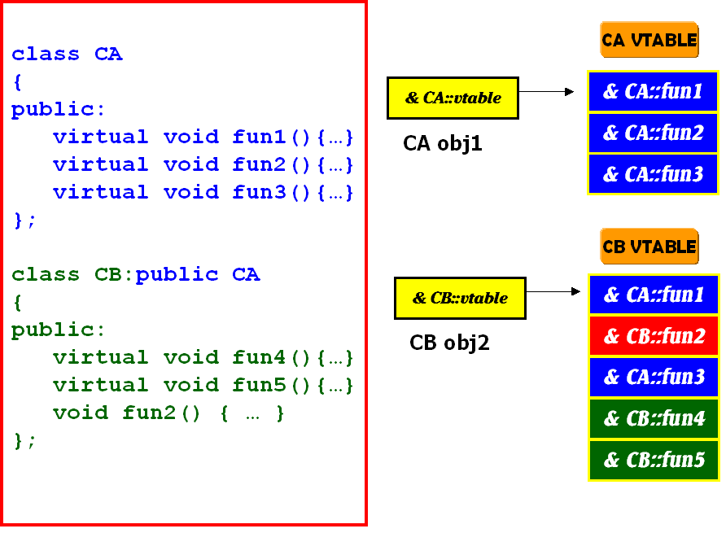
MULTI-LEVEL INHERITANCE & VTABLE LAYOUT

Slide 7
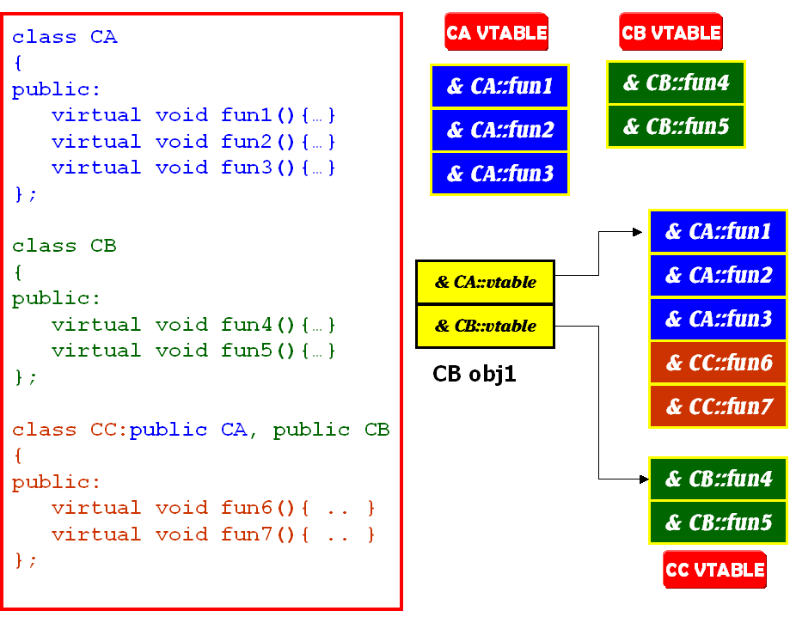
MULTIPLE INHERITANCE & VTABLE LAYOUT
CC obj1

Slide 8
RTTI TABLES
VTABLE
OBJECT
LOCATOR
CLASS
HIERARCHY
& RTTI OBJECT
LOCATOR
-1
0
0
0
1
1
2
COUNT
(RTTI BASE CLASS ARRAY)
2
& TYPE DESCRIPTOR
& RTTI BASE CLASS ARRAY
3
3
& CLASS HIERARCHY
DESCRIPTOR
4
& RTTI BASE CLASS DESCPR.
BASE CLASS
ARRAY
CONST TYPEINFO &
& RTTI TYPE DESCRIPTOR
0
0
1
1
2
2
BASE CLASS
DESCRIPTOR
3
RTTI TYPE
DESCRIPTOR
4
RTTI TABLE Used by dynamic_cast operator function
5
6

